Slide 1

FUNDAMENTALS AND IMPROVEMENTS FOR DIRECTIONAL RELAYS.
TECHNICAL REVIEW AND SEMINAR-IV
DEPARTMENT OF EEE
IV year -1semester
Academic year: 2020-2021
Presented By:
18985A0208 – A.SAI SAMPATH
18985A0232 – G.CHINNA
18985A0247 – L.RATNAKARA RAO
18985A0271 – Y.VASUDEVA
FACULTY:
Dr. Vasu Ganji
Associate professor
RAGHU ENGINEERING COLLEGE
(AUTONOMOUS)

Slide 2
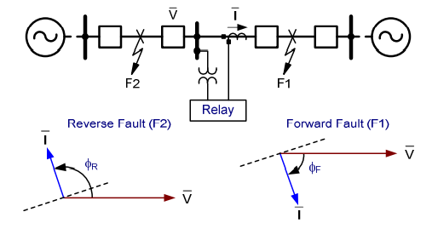
Introduction.
Directional elements determine the fault direction. They are used to control overcurrent elements, supervise distance elements for increased security, and form quadrilateral distance characteristics. Generally, directional elements are not applied alone, although they can be in unique applications.
Directional elements respond to the phase shift between a polarizing quantity and an operate quantity.

Slide 3
What Is Directional Relay?
Directional Over Current Relay, this is also a special type of over current relay with a directional features. This directional over current relay employs the principle of actuation of the relay, when the fault current flows into the relay in a particular direction. If the power flow is in the opposite direction, the relay will not operate. Normally. the conventional over current relay (non-direction) will act for fault current in any direction.

Slide 4
Construction of Directional Power Relay.
The upper magnet consists of primary winding on the central limb which is energized by voltage from secondary of P.T
Lower magnet houses secondary winding which is energized by current of the circuit from secondary of C.T.
Further lower magnet is connected to PSM as previous case (not shown).
In between this two electro magnets we have aluminum disc pivoted as shown
This aluminum disc carries a moving contact which can bridge fixed contact by rotating though a pre set angle.
The time of operation depends upon the pre set angle, Restraining torque is provide by spring which twists in reverse direction.

Slide 5
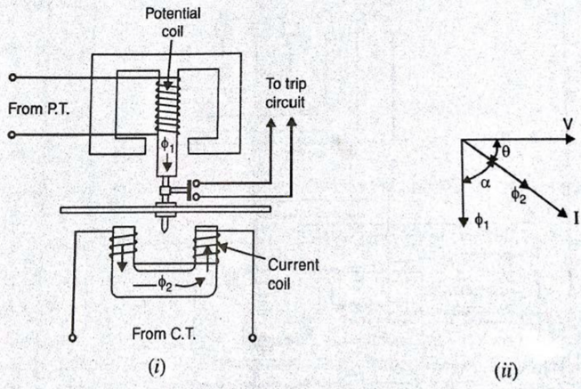
Directional Power Relay.

Slide 6
Operation of Directional Relay
from the diagram we can conclude that we have two flux quantaties:
φ1 & φ2 . always φ1 lags V by 90 0 φ2 inphase with current I
Due to phase difference between two flux quantities i.e.,
α= 90-θ
Φ1 αV & φ2 αI
Hence T = φ1 φ2 sin α
= φ1 φ2 sin(90-θ)
= VI COSθ = POWER
Hence the relay activated only when there is a specific direction of power flow.
when power flows in normal direction both driving torque and restraining torque twists in same direction and relay does not operates.
when the power flow is in reverse direction, driving torque and restraining torque acts in opposite direction and relay operates.
Therefore CB operates and disconnects faulty section.

Slide 7
Improvements Made Through Time.
Electro-Mechanical Relay Design
Electromechanical induction cup relays were essentially two-phase motors with two coils of wire wound around four poles of an electromagnet. Polarizing and operate quantities were applied individually to the two windings. In the center was a magnetic core with a movable cup with contacts and a spring to provide reset tension. The relay was designed such that no rotational movement or torque occurred when the magnetic fluxes of the two coils were in phase.
Early Micro-Processor Based Relay Control(1980s)
Early microprocessor-based directional elements ushered in a wave of innovations. The microprocessor design lowered costs, improved design and installation ease, and allowed for computational solutions to problems mentioned previously.

Slide 8
Contd.
3. Microprocessor-Based Relay Evolution (1993).
When the source behind the relay is strong, the voltage measured at the relay location for a remote fault can be too small to overcome the minimum torque requirements of a torque-product directional element. . In 1993, a new approach was introduced using the ratio of negative-sequence voltage and current (or negative-sequence impedance, Z2) rather than the product.
4. Microprocessor-Based Relay Evolution (1996).
Calculating thresholds ZF2 and ZR2 in the 1993 relay requires running fault studies and careful analysis. Thresholds were set to detect unbalanced faults under the strongest anticipated negative-sequence source conditions.

Slide 9
Features of directional relays
High speed of operation.
High sensitivity.
Ability to operate with low values of voltage.
Adequate short-time thermal rating.
Burden must not be excessive.
There should be no voltage creep and current creep. That is, if either the voltage coil alone or the current coil alone is energized with the other one unenergized there should be no movement.

Slide 10
Conclusion.
Directional element designs continue to evolve as power systems challenge relays. Electromechanical and early microprocessor-based relays were less sensitive and could not easily respond to system changes.
Newer designs are more sensitive and flexible, but sensitivity levels must be studied.
Automatic settings for directional elements are helpful but can be misapplied if not clearly understood. They should be applied with caution and review, with an understanding of the assumptions made.

Slide 11
Thank You.

